Slide 1
Ignite Your Future
Making a FULL TIME Living
as a FIRED UP Communicator

Slide 2
How do we set our future on F.I.R.E.?

Slide 3
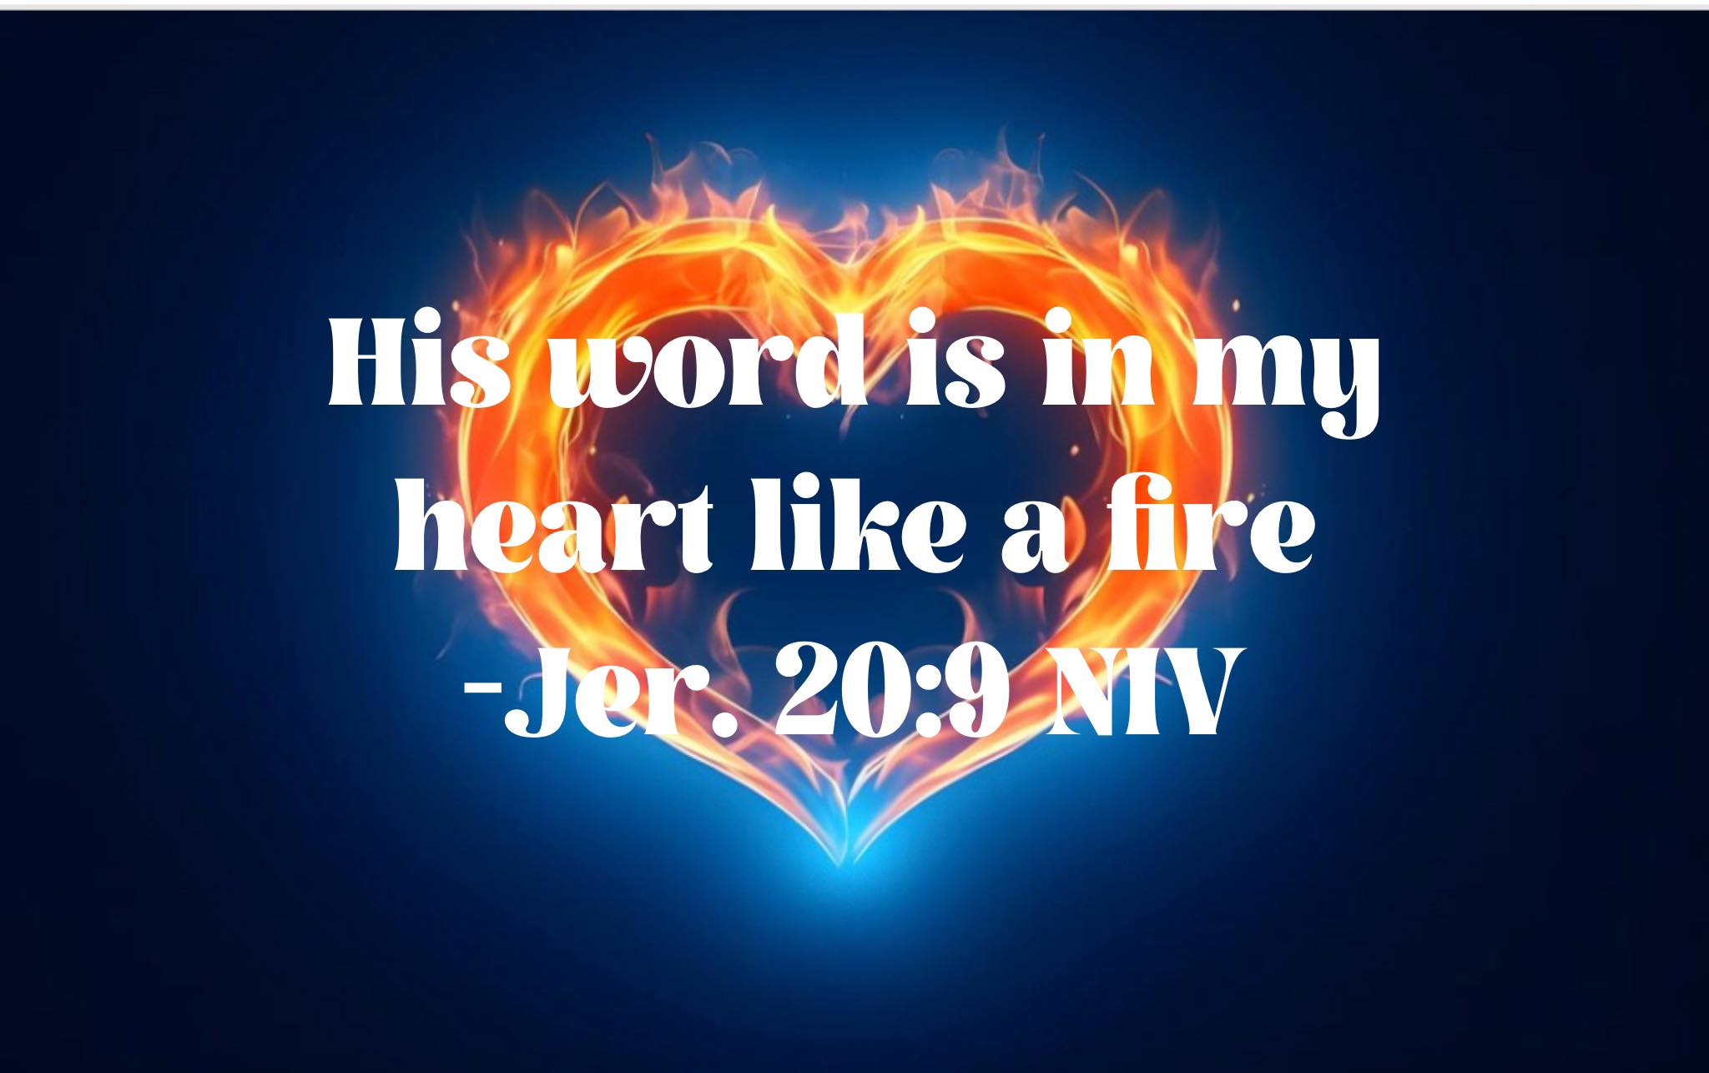
But if I say, “I will not mention his word or speak anymore in his name,” his word is in my heart like a fire, a fire shut up in my bones. I am weary of holding it in; indeed, I cannot. (Jeremiah 20:9 NIV)

Slide 4
Find Your Sweet Spot
I
R
E
Handouts: www.Love-Wise.com/Writeon
SPARK MEDIA IGNITE 2023

Slide 5
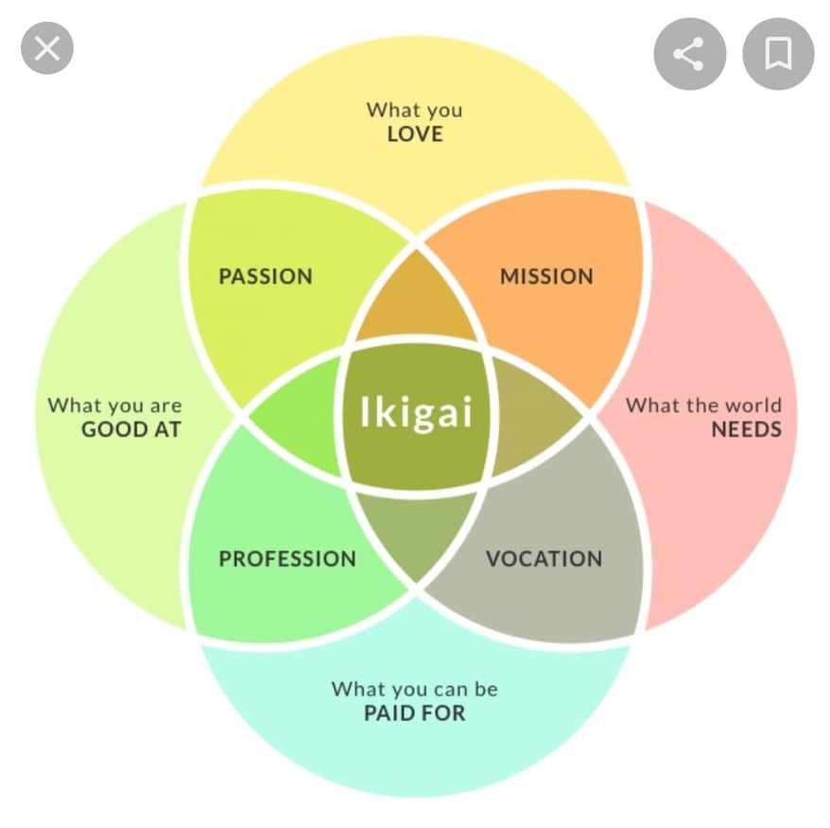
Ikigai: (ee-key-guy) Japanese: “Reason for being” or “Life-Worth” a motivating force; something or someone that gives a person a sense of purpose or a reason for living. (Oxford Dictionary)

Slide 6
Your Sweet Spot
Questions for Clarity
What do you love?
What are you great at?
What does the world need?
What can you get paid for?
*What do people always ask you for?

Slide 7
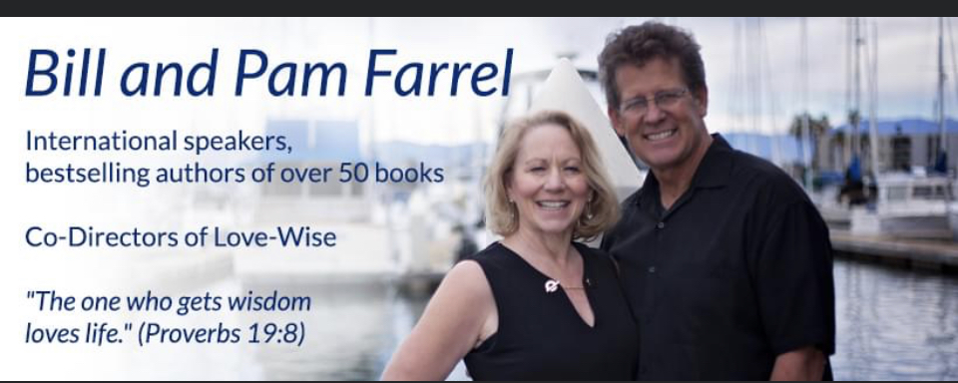
Find Your Sweet Spot
Invest In A Grand Idea
R
E

Slide 8
Invest In A Grand Idea (study ECPA monthly bestsellers)
Evangelical Christian Publishers Association (ECPA)
Unique Series- 10 Best
Unique Spin-Discovering series
Unique Slant- Your story
(ie, went to moon, survived trauma)
Unique Title- w/s

Slide 9
Listen for
God’s Inspiring
Whisper
Call to me and I will answer you and tell you
GREAT and MIGHTY things that you do not know
(Jer 33:3)

Slide 10
Find Your Sweet Spot
Invest In A Grand Idea
Ramp Up Multi-streams
E
SPARK MEDIA IGNITE 2023

Slide 11
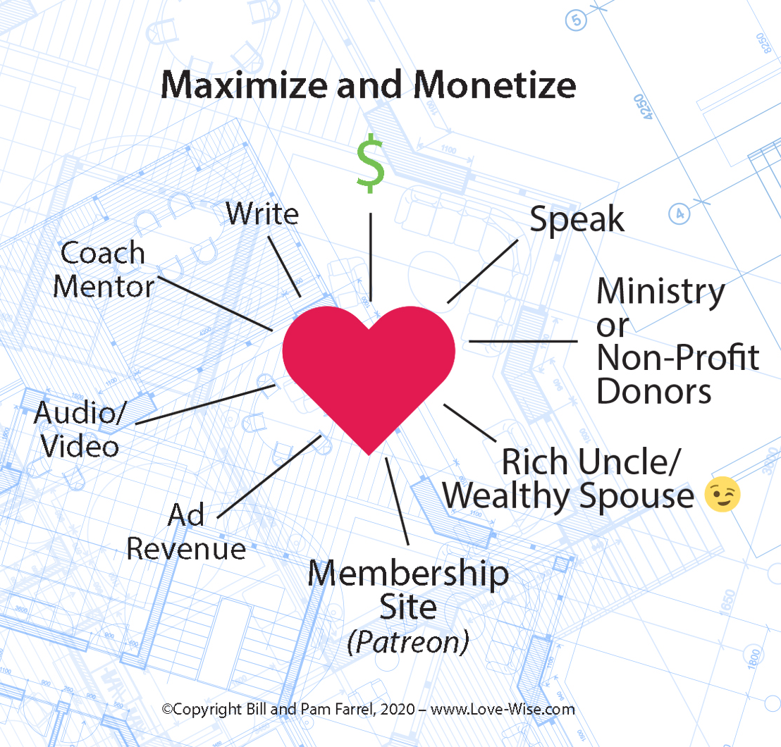
Brainstorm Multi-streams!
Write
Non-fiction AND Fiction
Traditional AND Indie
Ebook
Ancillary Products
Translations
Rejacket/ Rerelease
Create Publishing company
Become an Agent
Speak
Virtual AND Live Leaders
Church Community
Political Military
Biz Educational

Slide 12
Brainstorm Multi-streams!
Audio/Video
Courses
Audio books
You-Tube/Vimeo channel
Podcasts
Ad Revenue
You sell ad space on your virtual or event space
AdSense etc
Write marketing content for others
Show/ conference sponsors
Media influencer/Brand spokesperson

Slide 13
Brainstorm Multi-streams!
Membership site/Coaching/Counseling
Patreon (or alternative)
Non Profit / Ministry Donors
Ministry JOB
Affliate
Retirement or investments
Online or Brick and Mortar Bookstore
Side Hustle (real estate, Air B and B, travel)
Lower Your Overhead (Live Tiny/Pay Off Debt)
Inheritance!
For Profit at Non Profit Worksheet
www.Love-Wise.com/Writeon

Slide 14
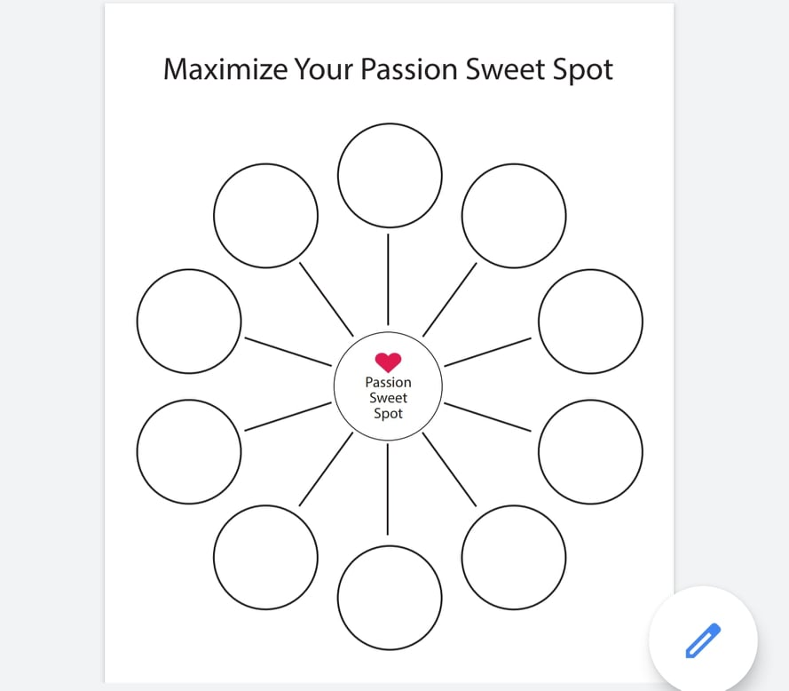
Your Turn to Brainstorm!
Worksheet at:
www.Love-Wise.com/Writeon

Slide 15
Find Your Sweet Spot
Invest In A Grand Idea
Ramp Up Multi-streams
Energize Your Bold Faith
SPARK MEDIA IGNITE 2023

Slide 16
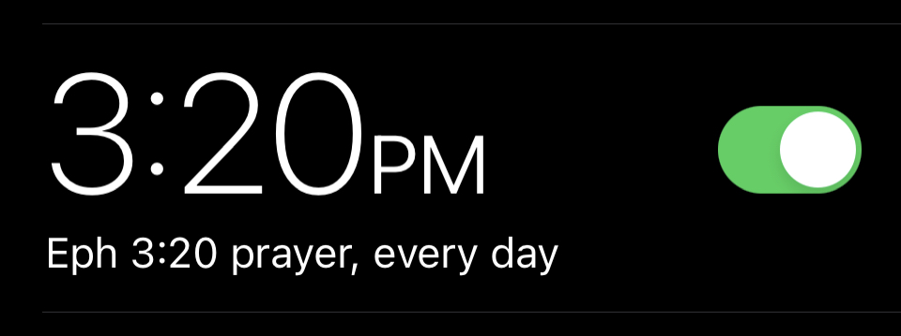
Energize Bold Faith
Now to Him who is able to [carry out His purpose and] do superabundantly more than all that we dare ask or think [infinitely beyond our greatest prayers, hopes, or dreams], according to His power that is at work within us,
(Eph 3:20 AMP)

Slide 17
Energize Bold Faith- Plan Well- Pray Big
Now to Him who is able [dunamai – DYNAMITE POWER] to [construct and cause] carry out His purpose and do [huperekperissou= superabundantly] more [huper=BEYOND] than all [every kind] that we dare ask or think [or perceive] infinitely beyond our greatest prayers, hopes, or dreams], according to His power [dunamis= dynamite]that is at work within us (His Holy Spirit!), (Eph 3:20 AMP)
“

Slide 18
Show me the size of your God,
I will show you size of your opportunity. BIG GOD- BIG Opportunity

Slide 19
Set Your Future On …
Find Your Sweet Spot
Invest In A Grand Idea
Ramp Up Multi-streams
Energize Your Bold Faith
Handouts www.Love-Wise.com/Writeon

